Slide 1
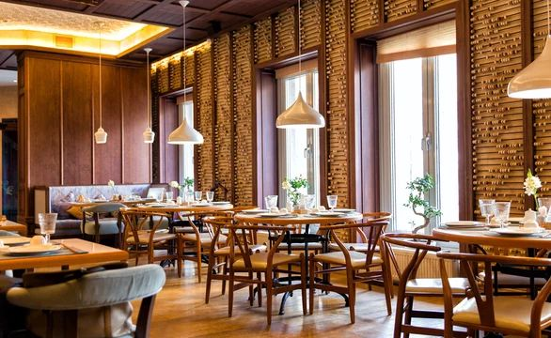

Introducing MZ.ZONE Restaurant Website:
A Culinary Journey Like No Other
© MZ .ZONE . All Right Reserved.

Slide 2
Benefits of Having a Website
In today's world, websites are powerful tools for communicating with customers, advertising, selling products and services, increasing brand awareness, and providing online services. Websites enable businesses to expand their target market, reduce advertising costs, and quickly respond to customer needs.
Website Definition:
A website is an online platform that provides access to information, services, and products of a business to customers. Through a website, customers can communicate with a business, place orders, and avail of its services.
.
Reasons for Using a Website:
A website allows customers to easily search for the information they need, place orders, communicate with the business, and benefit from its services. Additionally, websites are usually available 24/7, allowing customers to easily access the information they need.
Introduction
Website

Slide 3
Purpose of the MZ. ZONE website:
The website is designed to provide a convenient and user-friendly experience for our customers, allowing them to access information about our restaurant and services anytime, anywhere. It serves as a digital hub for all things related to MZ. ZONE, helping us connect with our customers and enhance their dining experience.
Benefits of the MZ. ZONE website:
By visiting our website, customers can easily browse our menu, learn about our culinary offerings, and make reservations from the comfort of their own home. They can also sign up for our newsletter to receive exclusive discounts and updates.
What is the MZ.ZONE website:
The MZ. ZONE website is an online platform where customers can explore our menu, make reservations, and stay updated on special events and promotions.
Introduction MZ.ZONE
Website

Slide 4
css
CSS stands for Cascading Style Sheets. It is a style sheet language used for describing the presentation of a document written in HTML or XML (including XML dialects like SVG or XHTML). CSS controls the layout, design, and appearance of a webpage, allowing web developers to style elements such as text, colors, fonts, spacing, and more.
HTML
HTML stands for Hyper Text Markup Language. It is the standard markup language used to create web pages. HTML provides the structure and layout of a webpage by using a series of elements and tags to define the content, such as headings, paragraphs, images, links, and more.
Transforming the project into beauty using HTML and CSS

Slide 5
Chrome
Chrome is a web browser developed by Google that allows users to access and navigate websites on the internet. It is one of the most popular and widely used browsers worldwide, known for its speed, simplicity, and user-friendly interface. Chrome supports various features such as tabbed browsing, bookmarks, extensions, and synchronization with Google accounts for personalized browsing experience across devices.
Sublime
Sublime Text is a popular text editor used by developers and programmers for writing code. It is known for its speed, flexibility, and powerful features that make coding more efficient and productive. Sublime Text supports various programming languages, syntax highlighting, auto-completion, multiple cursors, and a wide range of plugins and packages to enhance functionality.
Photoshop
Photoshop is a popular image editing software developed by Adobe Inc. It is widely used by photographers, graphic designers, web designers, and other creative professionals to edit and manipulate images. Photoshop offers a wide range of tools and features that allow users to enhance photos, create digital artwork, and design graphics for print or web.
Utilizing Tools for Website Project Development

Slide 6

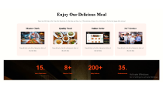
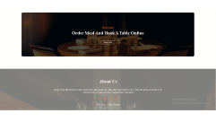
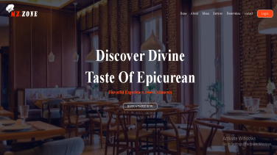
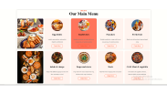
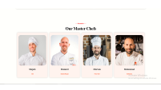
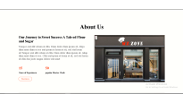
Home
About
Menu
Services
Reservation
Contact
the Home Page of Website
The home page of a website serves as the virtual front door to an online platform, often acting as the first point of contact for visitors. It is the primary landing page that users encounter when they navigate to a website's domain. The home page typically includes essential elements such as a navigation menu, company logo, search bar, and a brief introduction to the site's purpose or offerings. It may also feature featured content, promotions, or highlights to engage visitors and encourage further exploration of the website.
Login
Signup

Slide 7
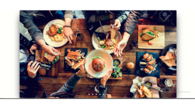
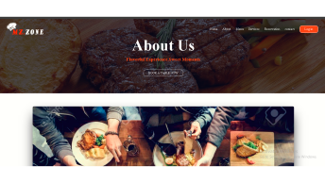
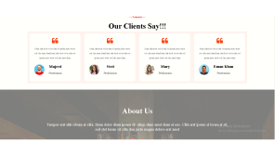
Home
About
The About Us page
Menu
Services
Reservation
Contact
Content:
- Introduction to the website and its purpose
- Overview of the company's background and values
- Testimonials or customer reviews showcasing positive feedback
- Mission statement or key objectives of the website
Design Elements:
- Use a clean and professional layout
- Incorporate the website's branding elements (logo, color scheme)
- Include visuals such as images or icons related to the company or industry
- Utilize bullet points or short paragraphs for easy readability
Login
Signup

Slide 8
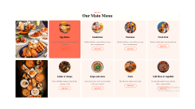
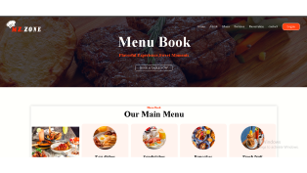
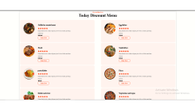
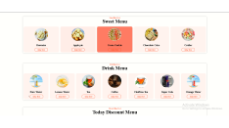
Home
About
Menu
Services
Menu Book Page
Reservation
Contact
Login
we have four types of menus on our menu page:
- Daily Specials Menu or Discount Menu
- Main Menu
- Drink Menu
- Dessert Menu
Signup

Slide 9
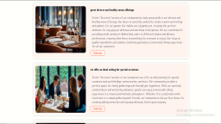
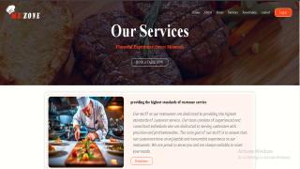
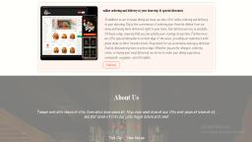
Home
Services Page
About
Our services page is divided into four main sections to cater to different needs and preferences. The first section highlights our personalized services, tailored to meet the unique needs of foreach individual. Whether you're looking a special gift for a loved one or a treat for yourself, our team is dedicated to providing top-notch service.
The second section focuses on our prime locations, perfect for hosting gatherings with family and friends. From intimate dinners to lively celebrations, our venues offer the ideal setting for creating unforgettable memories.
In the third section, we showcase our online ordering system, making it easy for customers to place orders from the comfort of their own homes. With just a few clicks, you can have your favorite dishes delivered straight to your doorstep.
Menu
Services
Reservation
Contact
Login
Signup

Slide 10
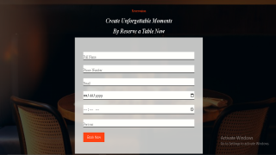
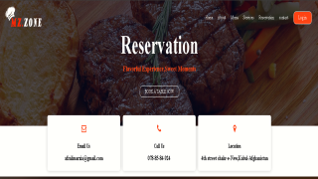
Home
About
Menu
Services
Reservation
Reservation page
Contact
Login
on the reservation page, customers can use contact information such as email, phone number, and location to contact restaurants. Additionally, they can reserve a table online for their desired time, enter their reservation details, and receive a confirmation.
Signup

Slide 11
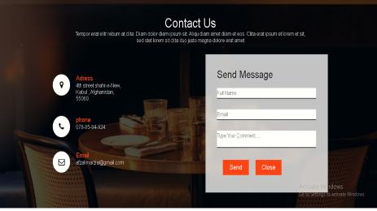
Home
Contact Page
About
on this page, customers can establish contact. If they need help or more information, customers can use the contact form or view direct contact information for the restaurants on the reservation page and contact them. Additionally, customers can send us their feedback, suggestions, or criticisms through the contact form so that we can respond to them and improve our services.
Menu
Services
Reservation
Contact
Login
Signup

Slide 12
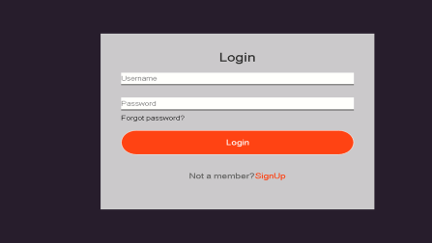
Home
About
Menu
Services
Reservation
Log in Page
Contact
A login page is a web page or interface that allows users to enter their username and password in order to access a secure system, such as a website, application, or network. The main purpose of a login page is to authenticate the user's identity and grant them access to specific resources or features based on their login credentials. Login pages are commonly used to protect sensitive information, secure user accounts, and personalize user experiences.
Login
Signup

Slide 13
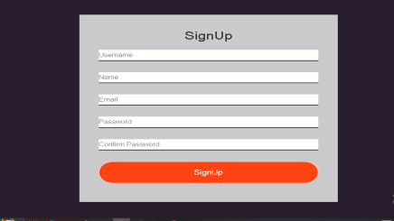
Home
Sign up Page
About
A sign-up page is a web page or interface that allows users to create a new account or register for a service. The main purpose of a sign-up page is to collect user information, such as name, email address, password, and other relevant details, in order to create a new user account.
Menu
Services
Reservation
Contact
Login
Signup

Slide 14
Thank You

Slide 15


Slide 16
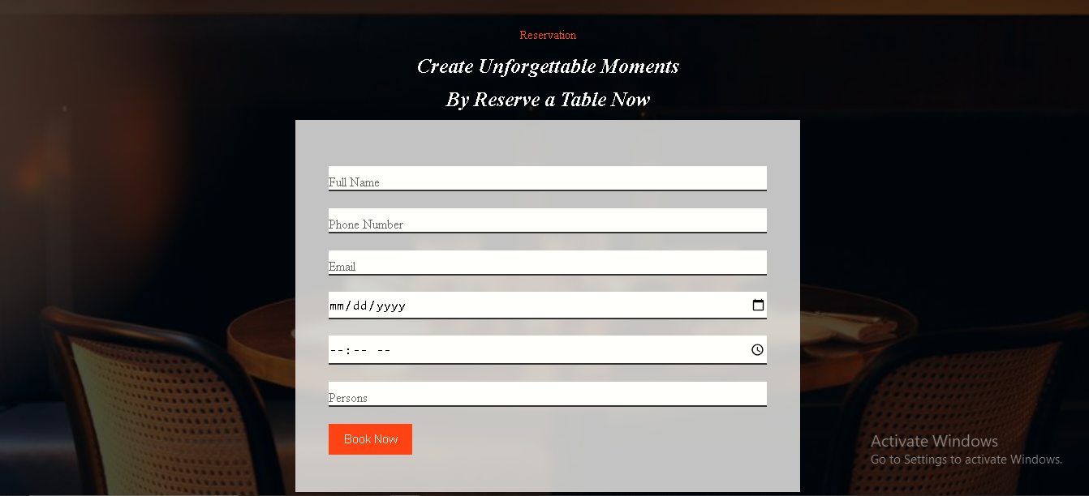

Slide 17
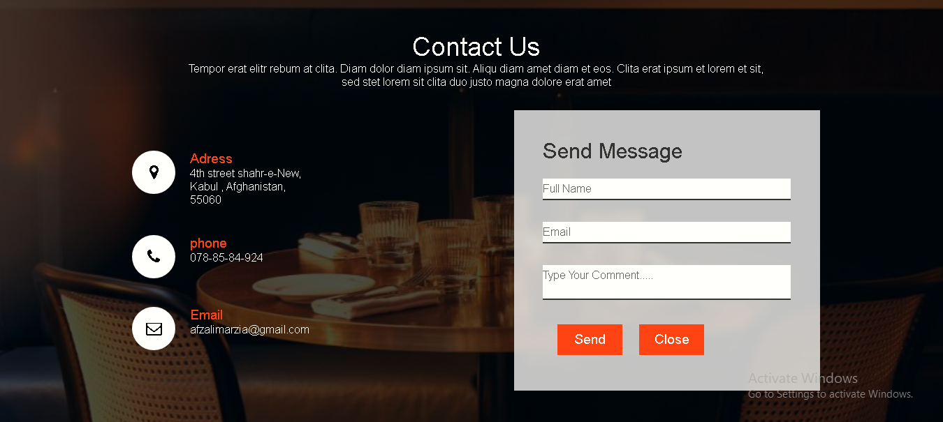

Slide 18


Slide 19


Slide 20


Slide 21
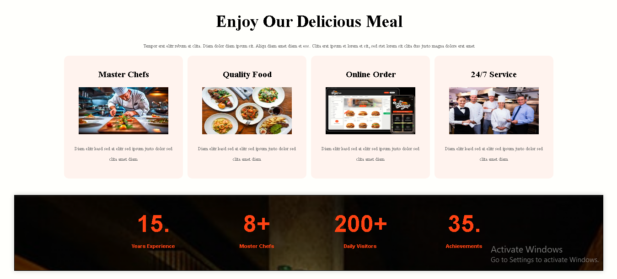

Slide 22
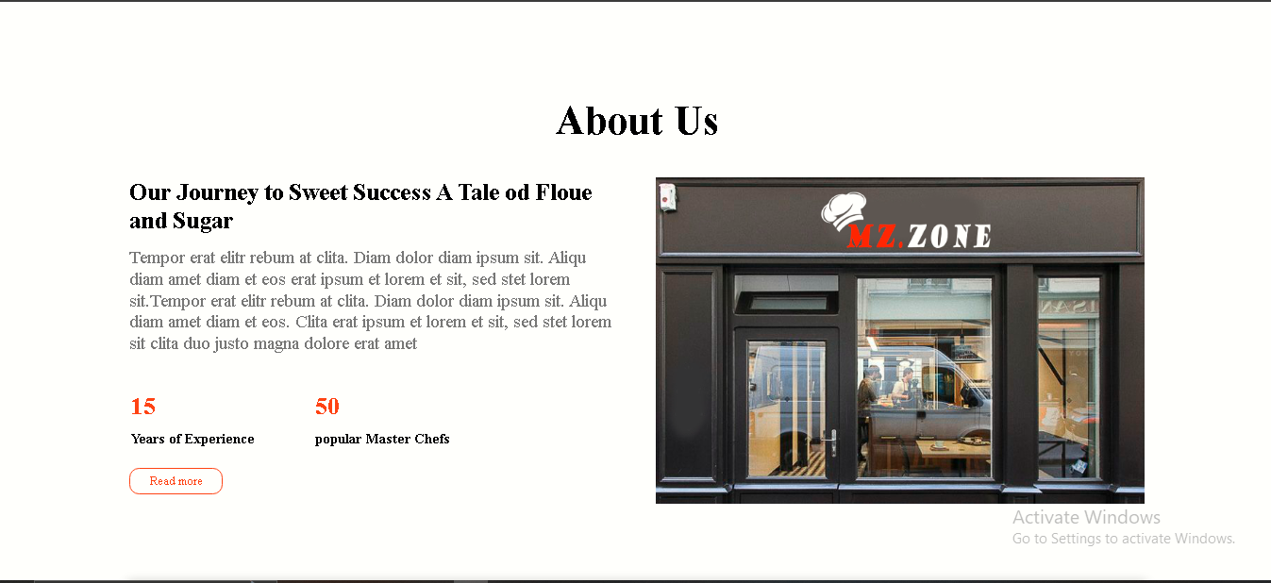

Slide 23
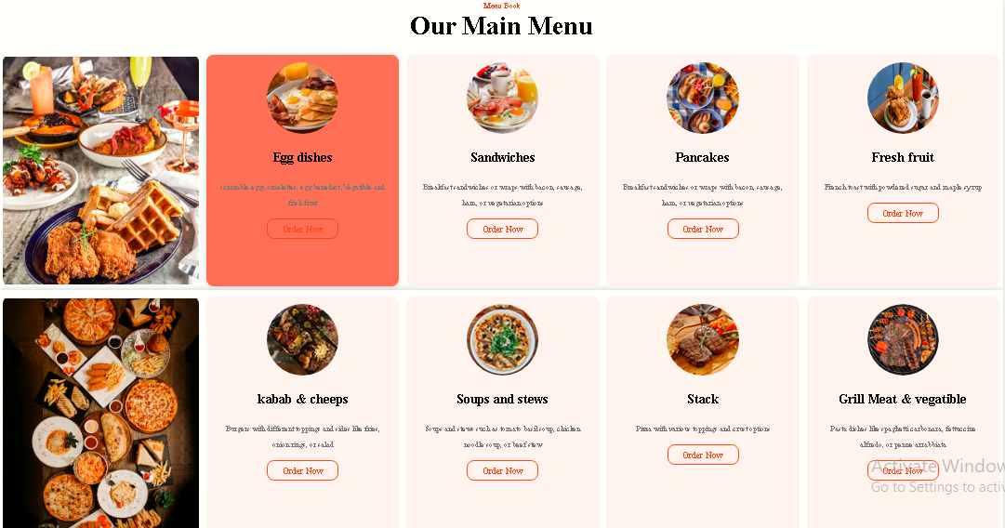

Slide 24
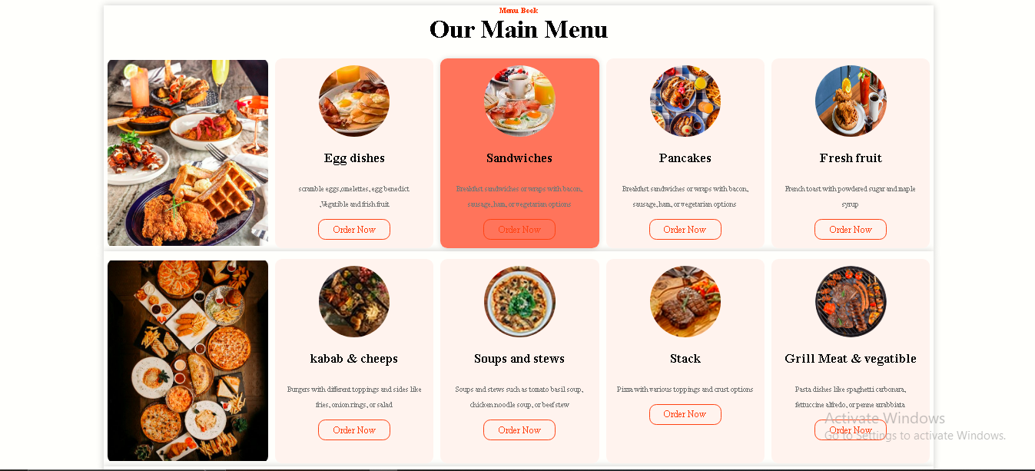

Slide 25
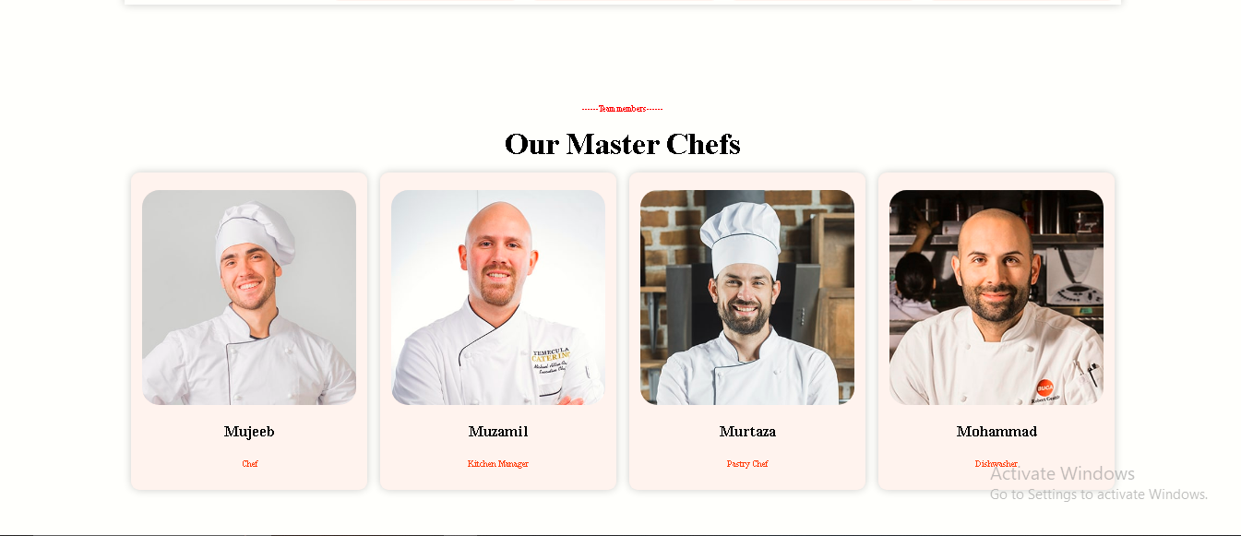

Slide 26
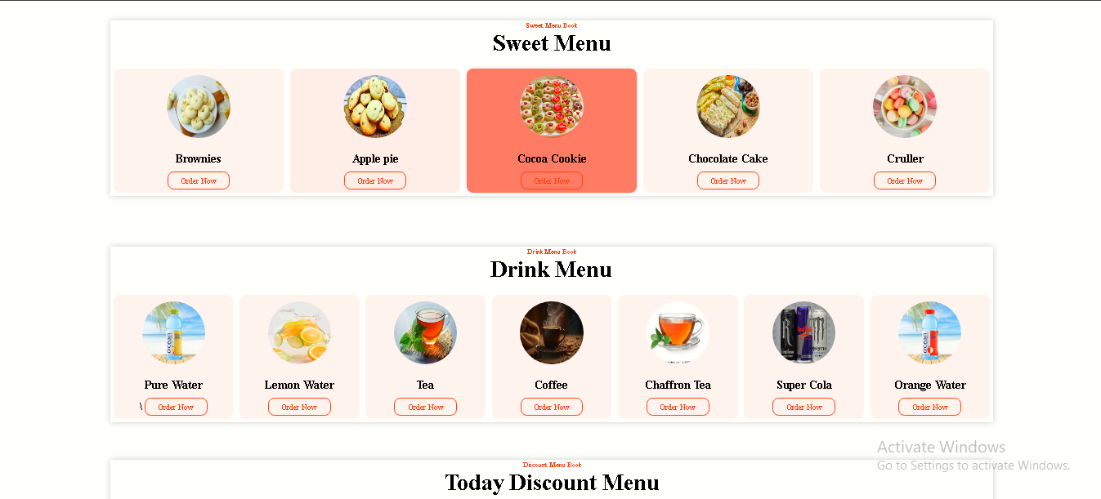

Slide 27
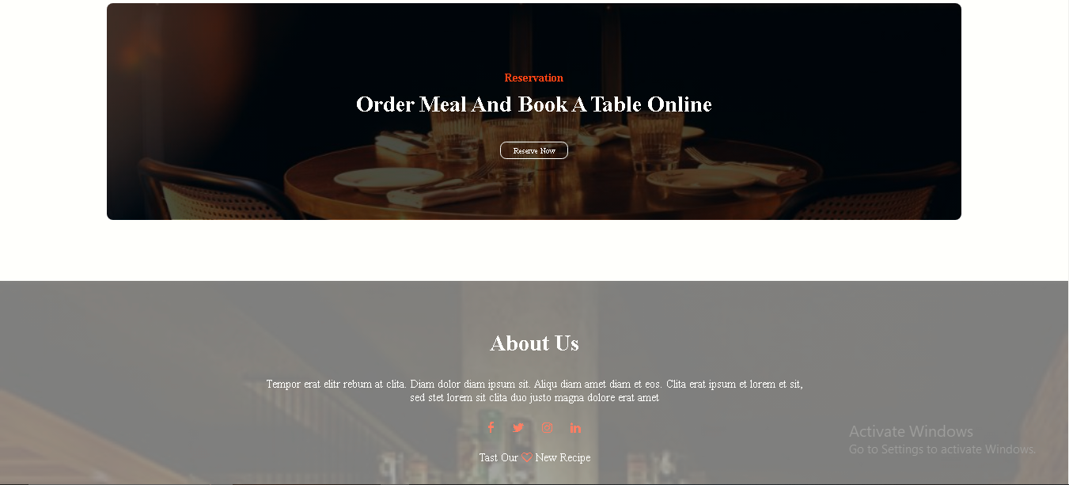

Slide 28
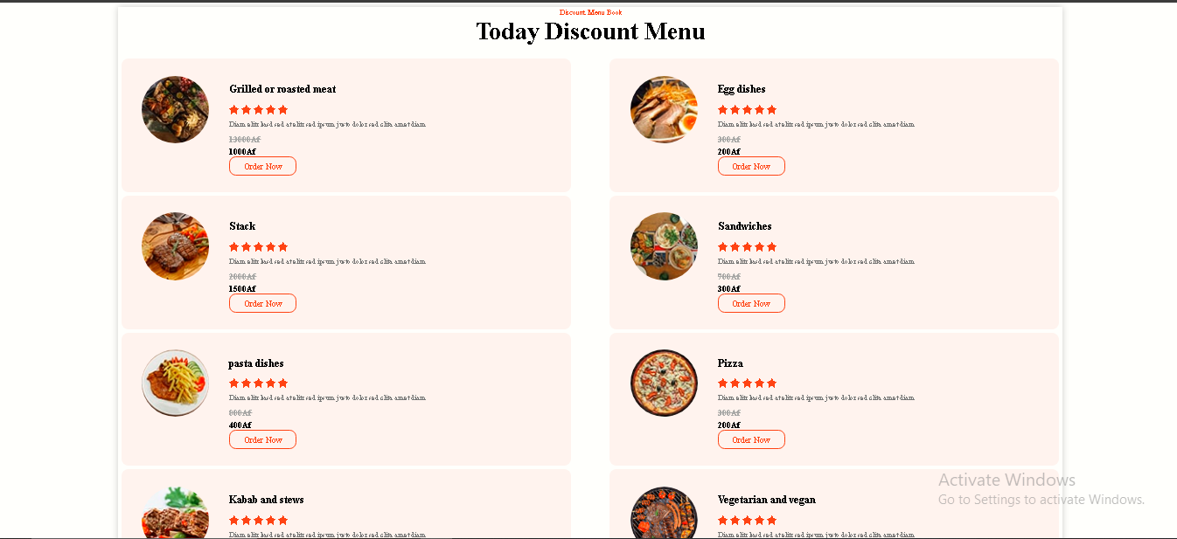

Slide 29
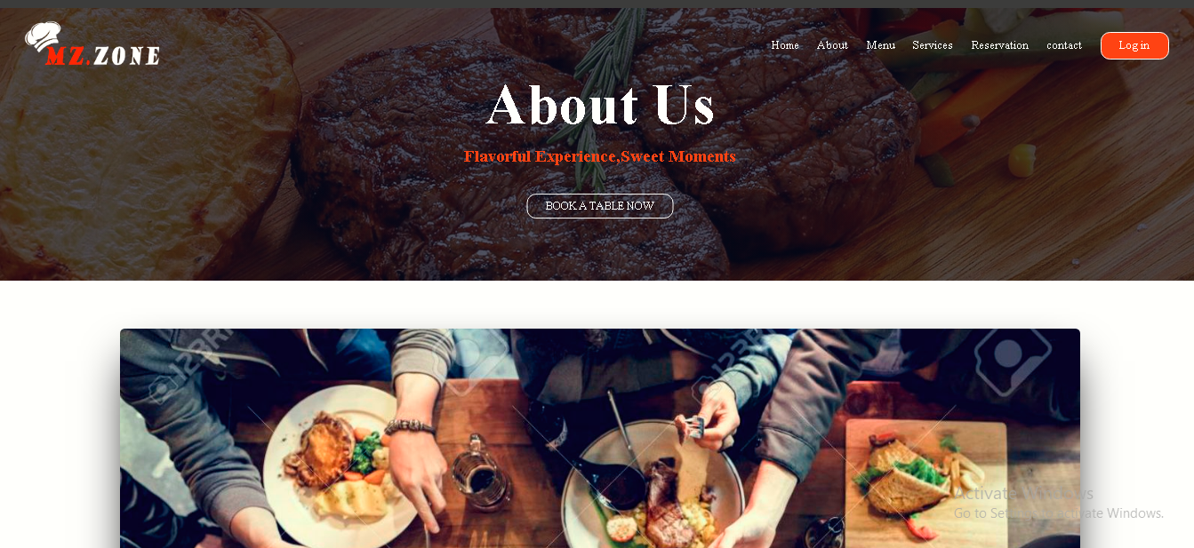

Slide 30
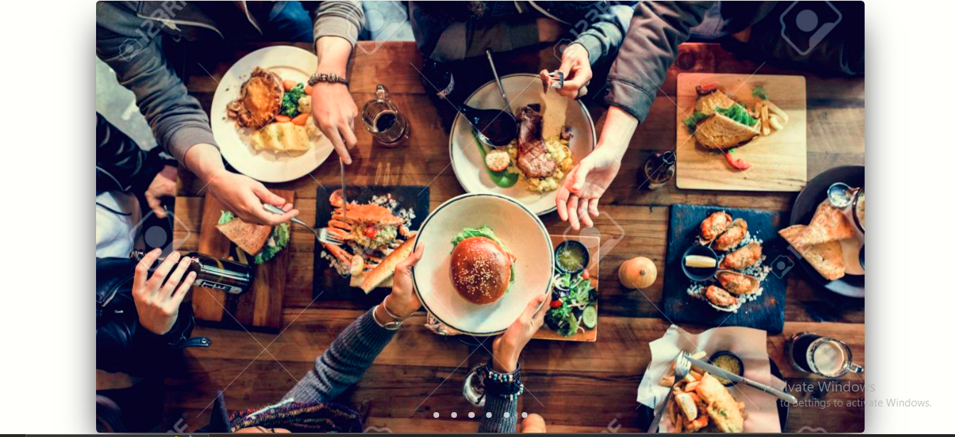

Slide 31
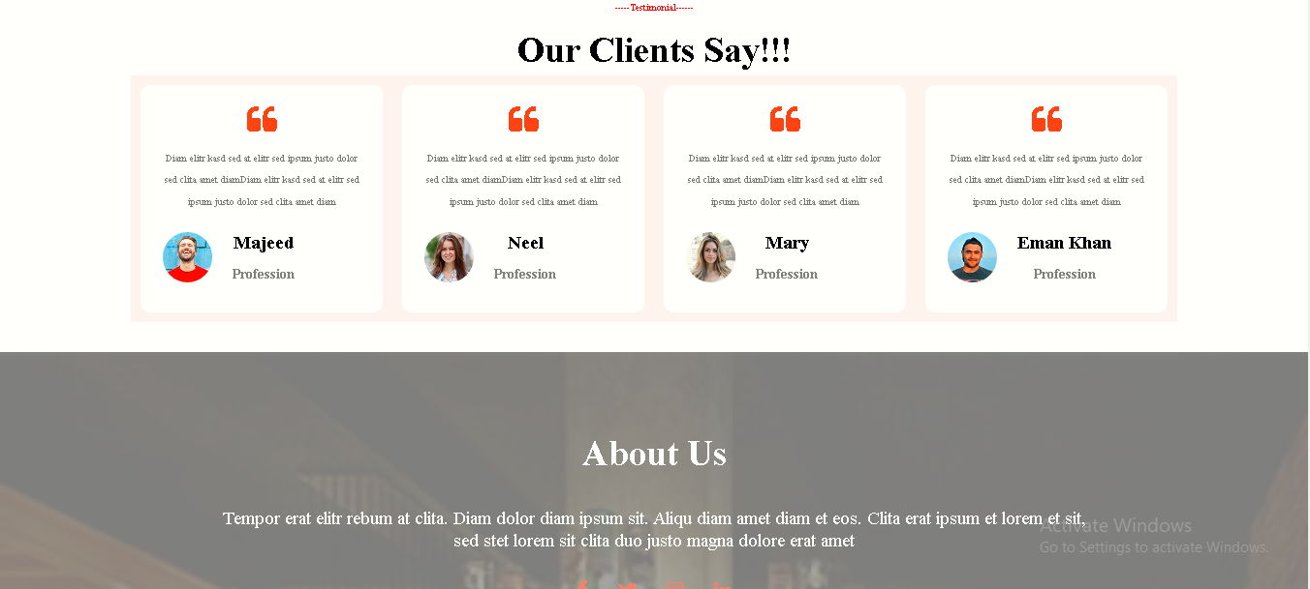

Slide 32
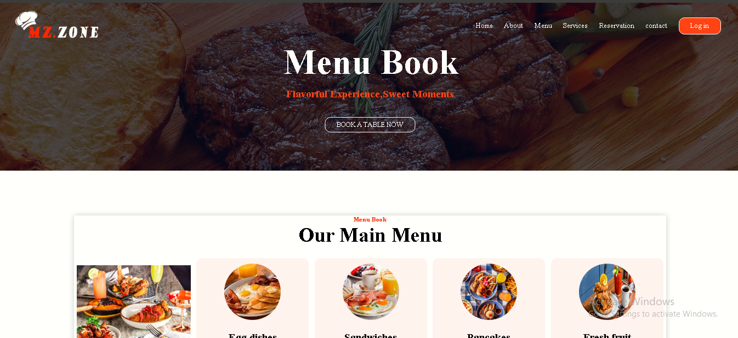

Slide 33
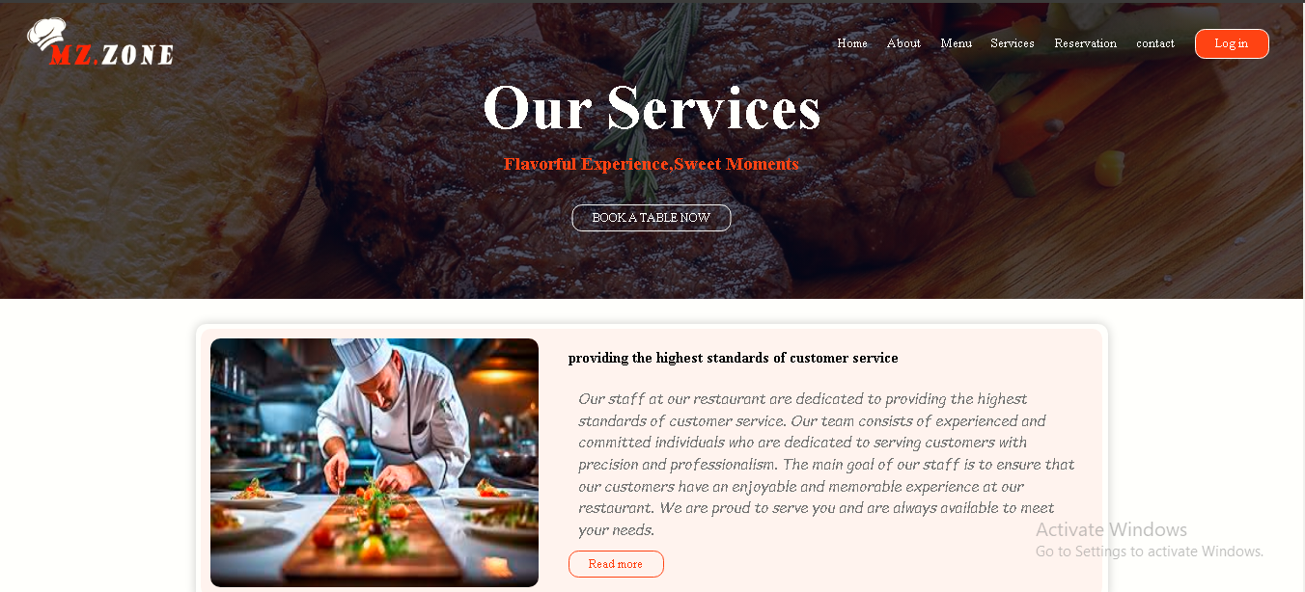

Slide 34


Slide 35
